Slide 1

Foresight Law + Policy Policy Forum:
A panel discussion featuring former NSBA Executive Director Tom Gentzel about LEA Innovation
Video | October 28, 2020

Slide 2
Introduction
School boards and public “ownership”
Engines of education improvement
Pandemic challenges, opportunities

Slide 3
The Need
Compliance and safety
Lack of connectivity, devices
The surprise is over

Slide 4

Planning and Leadership
Agile leaders
Barriers
Practices
Evaluation
Improvement

Slide 5

Communication and Engagement

Slide 6
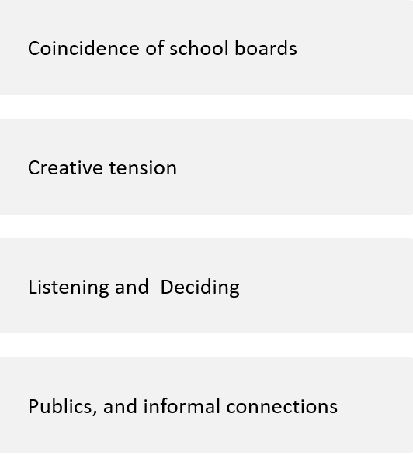
Communication and Engagement

Slide 7
Communication and Engagement
Plan!
Build alliances
Communicate with everyone
Revise as needed

Slide 8
PROMOTING EQUITY
Hear
Hear all voices
Engage
Engage not just when problems emerge
Ensure
Ensure equitable resource distribution – among schools, among roles
Support
Support diverse schools
Leverage
Emphasize Data and analytics

Slide 9
Funding for Innovation
Funding constraints - especially given the pandemic - may make it very difficult to develop and pursue new innovations.
The CARES Act provided $13.5 billion for elementary and secondary schools and an additional $3 billion for governors that may be used for K-12 initiatives.
Congress granted schools the ability to use these funds for a vast array of activities and needs, including the innovation actions described by this paper.

Slide 10

Thomas J. Gentzel
Principal, Gentzel Insights LLC
Executive Director & CEO Emeritus,
National School Boards Association
Contact:
Phone: (717) 574-2536
Email: gentzelinsights@yahoo.com
Website: www.gentzelinsights.com
Twitter: @Tom_Gentzel

Slide 11
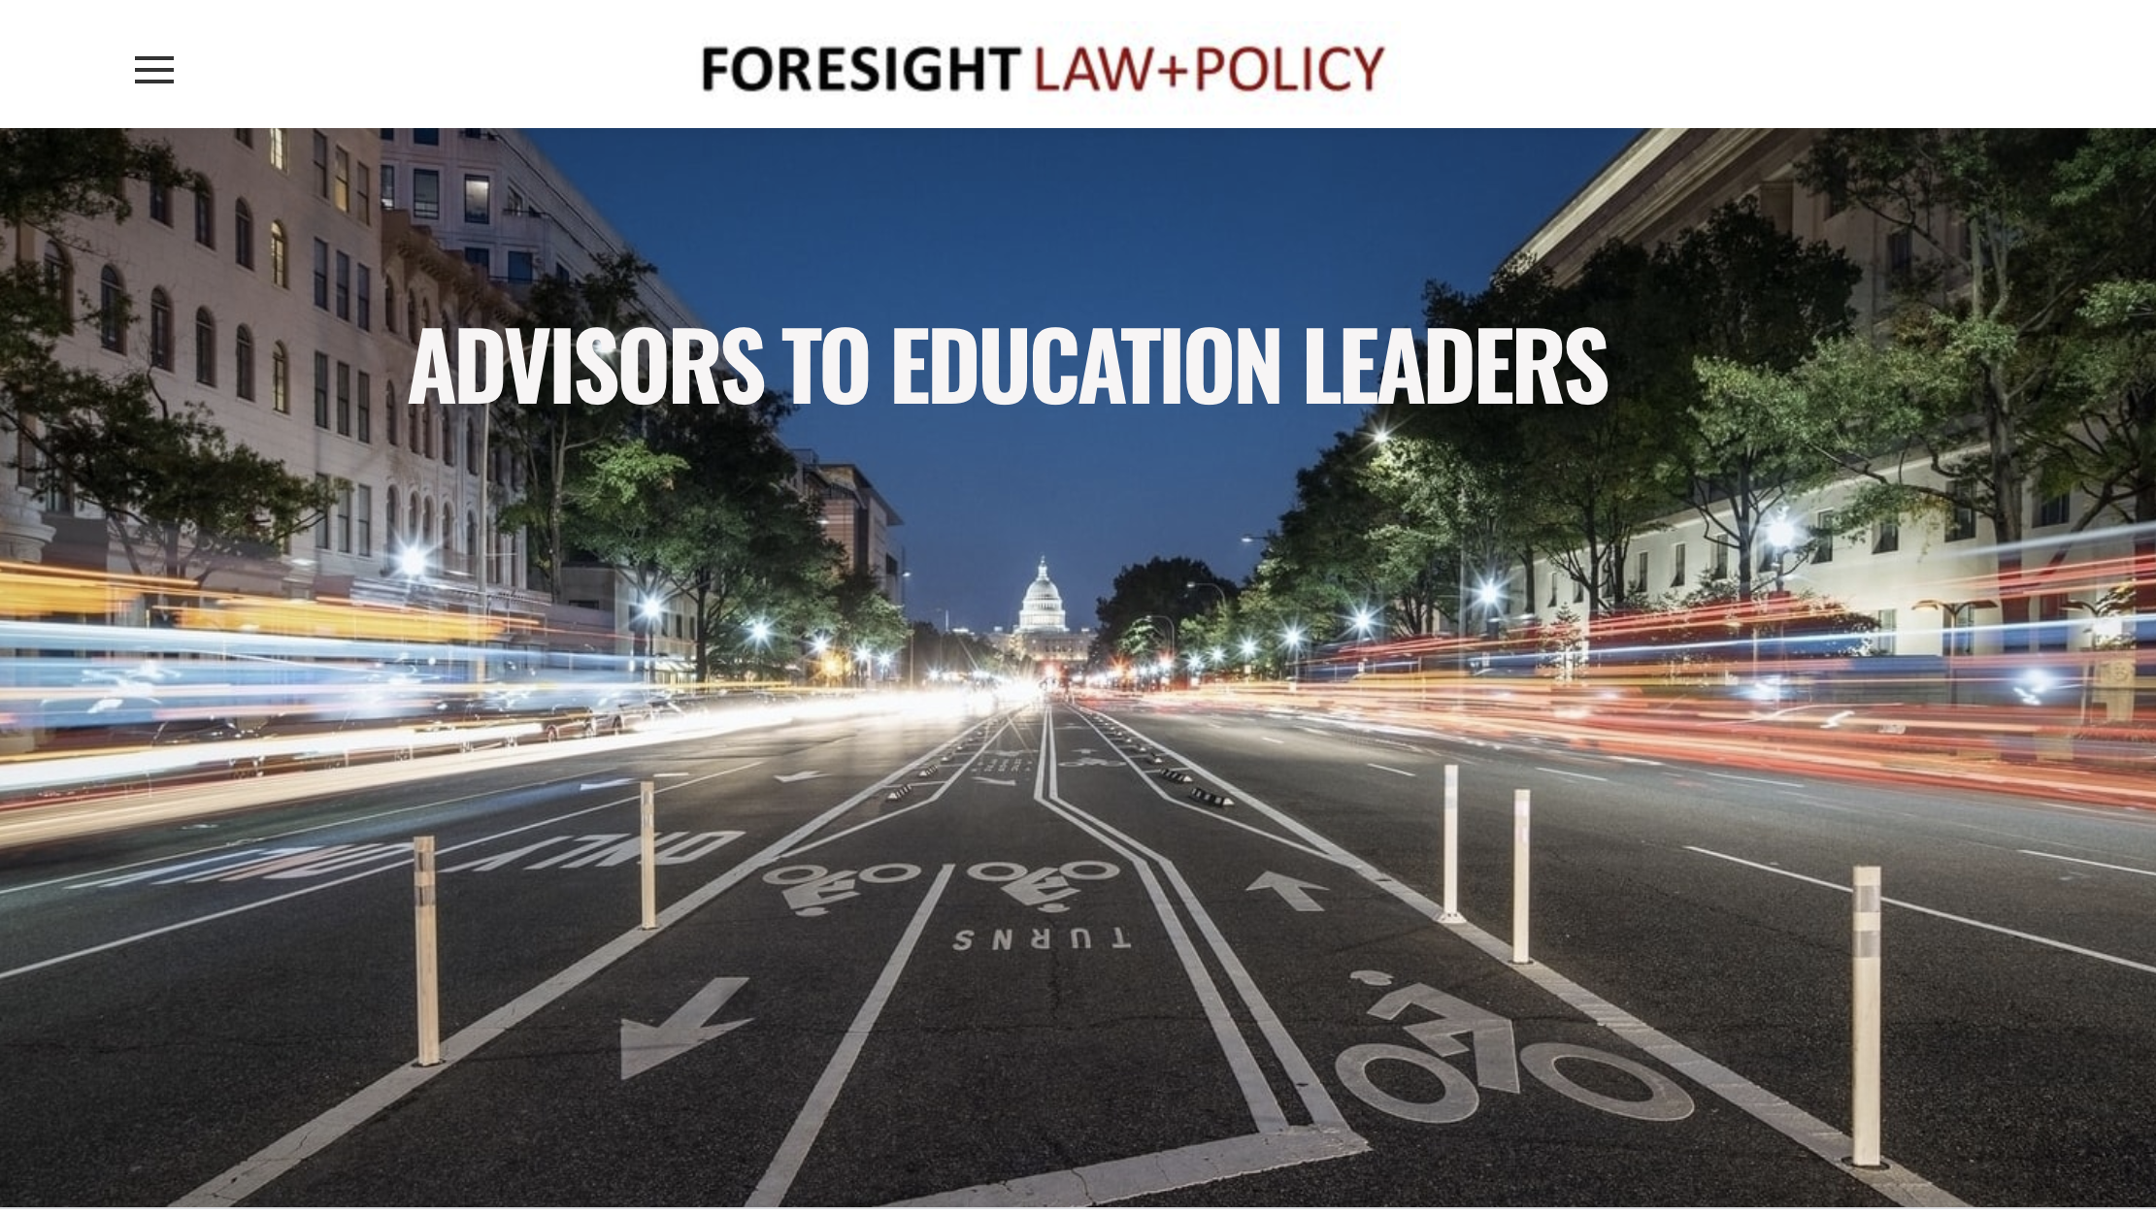


www.FLPAdvisors.com | 800 Maine Avenue, S.W., Washington, D.C. 20024

